Slide 1
Deep Learning Algorithms
Convolutional Neural Networks
Generative Adversarial Network

Slide 2
Convolutional Neural Networks
A convolutional neural network can have tens or hundreds of layers that each learn to detect different features of an image.
Filters are applied to each training image at different resolutions, and the output of each convolved image is used as the input to the next layer.
The filters can start as very simple features, such as brightness and edges, and increase in complexity to features that uniquely define the object.

Slide 3
Convolutional Neural Networks
Methodology:
It consists of layers that perform convolution operations, where small filters or kernels slide over the input data (like an image) to detect local patterns such as edges, textures, and shapes.
These convolutional layers are followed by pooling layers that downsample the feature maps, reducing their dimensionality and computational complexity while retaining the most important features.
After several convolution and pooling layers, the network typically includes fully connected layers to make final predictions or classifications.

Slide 4
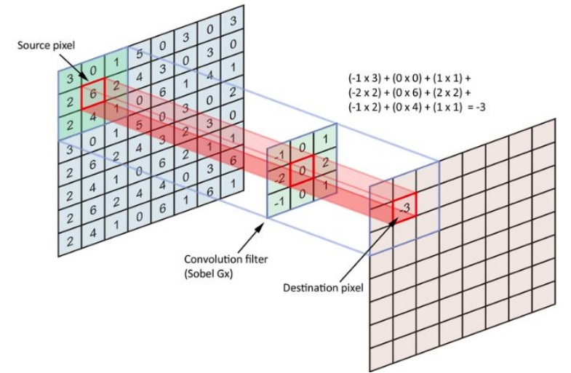
Convolution in 2D

Slide 5
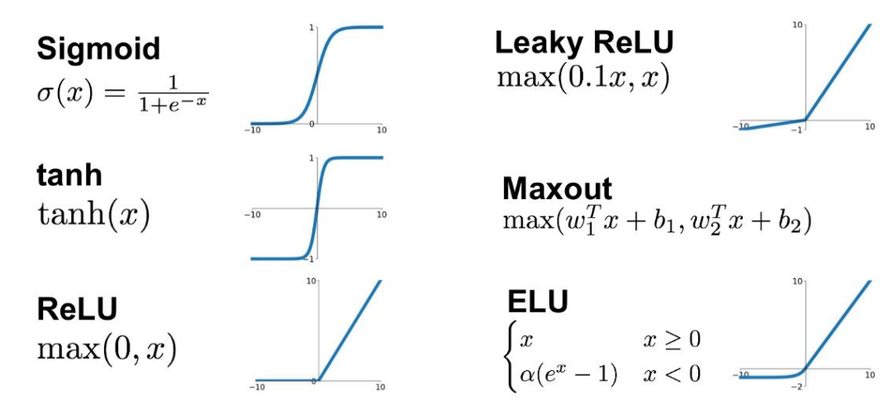
Activation Function

Slide 6
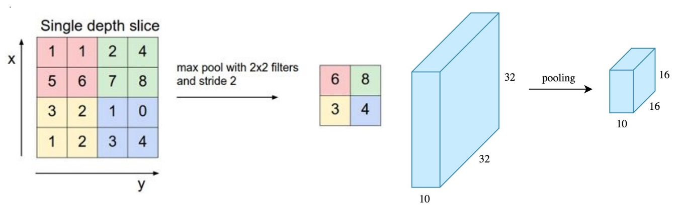
Max Pooling

Slide 7
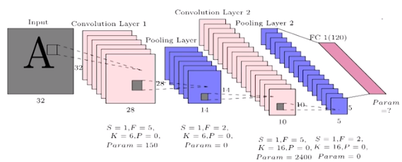
Convolutional Neural Networks

Slide 8
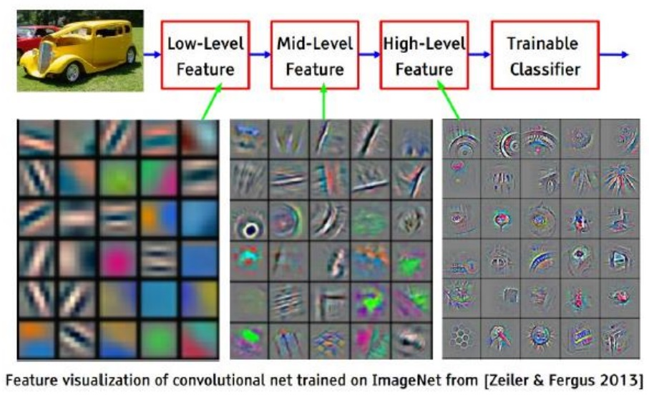
What do the neurons learn?

Slide 9
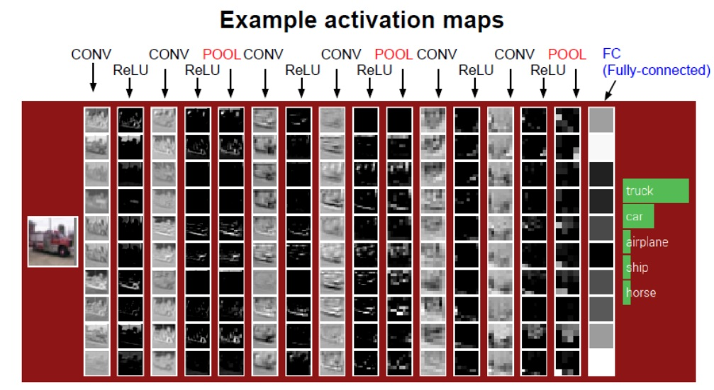
Example activation maps

Slide 10
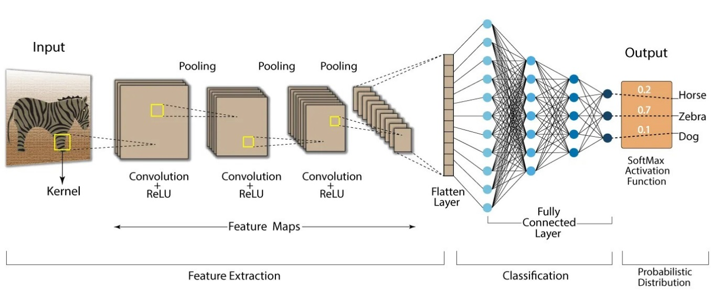
Representation

Slide 11
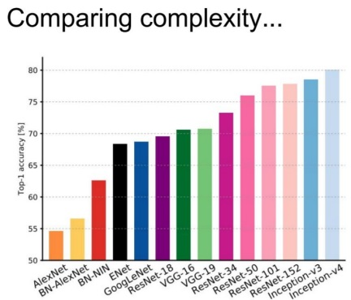
Computational Complexity

Slide 12
Key Takeaways
Use Cases: Image classification, object detection, facial recognition.
How It Works:
Convolutional layers apply filters to detect patterns.
Pooling layers reduce dimensionality.
Fully connected layers for final prediction.
Example: ImageNet classification (e.g., AlexNet, ResNet).

Slide 13
Generative Adversarial Network
A generative adversarial network (GAN) is a deep learning architecture.
It trains two neural networks (discriminator and generator) to compete against each other to generate more authentic new data from a given training dataset.
During training, the generator improves its ability to create more convincing data, while the discriminator becomes better at identifying fake data.

Slide 14
Generative Adversarial Network
This adversarial process continues until the generator produces data that is nearly indistinguishable from real data, and the discriminator is unable to tell the difference.
For instance, we can generate new images from an existing image database or original music from a database of songs.

Slide 15
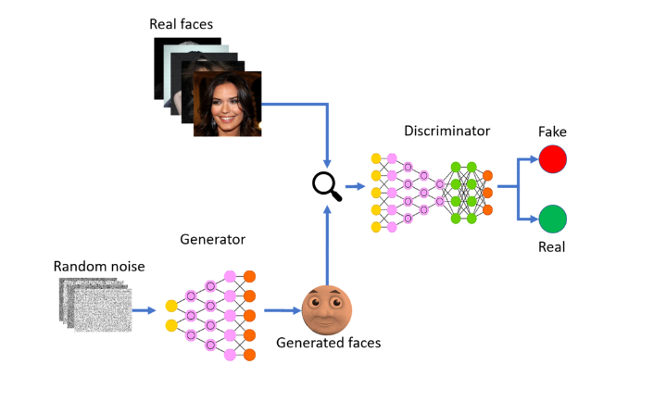
Generative Adversarial Network

Slide 16
Key Takeaways
What is a GAN?: A type of neural network architecture where two networks (Generator and Discriminator) compete against each other.
Use Cases: Image generation, style transfer, data augmentation.
How it Works:
Generator creates fake data.
Discriminator evaluates if the data is real or fake.
Both networks improve through adversarial training.

Slide 17
DL Models for Various Problems
Computer Vision – GANs and CNN
Natural Language Processing – BERT, Attention, Memory networks, RNN, LSTM, GRU and CNN
Adversary Attacks Detection – GAN
Object Detection – YOLO models

Slide 18
DL Models for Various Problems
Semantic Segmentation – Mask RCNN
Image Classification – CNNs
Sequence Problem Prediction – RNN, LSTM, GRU
Linear Problems Modeling and Analysis – ANN

Slide 19
Current research trends in DL
Transfer Learning: Fine-tuning pre-trained models for specific tasks.
Explainability: Making deep learning models interpretable to humans (e.g., SHAP, LIME).
Self-Supervised Learning: Leveraging unlabeled data to pre-train models.
AI Ethics and Bias: Addressing fairness and reducing bias in AI models.
Edge AI: Deploying deep learning models on edge devices (e.g., smartphones, IoT).

Slide 20
Future Directions
Meta-Learning: Training approaches used for small-scale instances
fault-tolerant deep learning models for small training data
Deep learning model execution over mobile devices
Use of DL in neuroscience
Applications of deep learning in game theory
Extracting complete information from partial information using DL
Deep learning in quantum environment
GenAI, XAI

Slide 21
Challenges
Time-consuming process
Using small-scale data leads to overfitting issue
Observation-based learning
Use large-scale data for processing
Training / Processing of large data is costly
Hardware constraints and cost

